Slide 1
T1 A3 - ‘The Forgotten’
Text Adventure Game
Sneha Bhamra

Slide 2
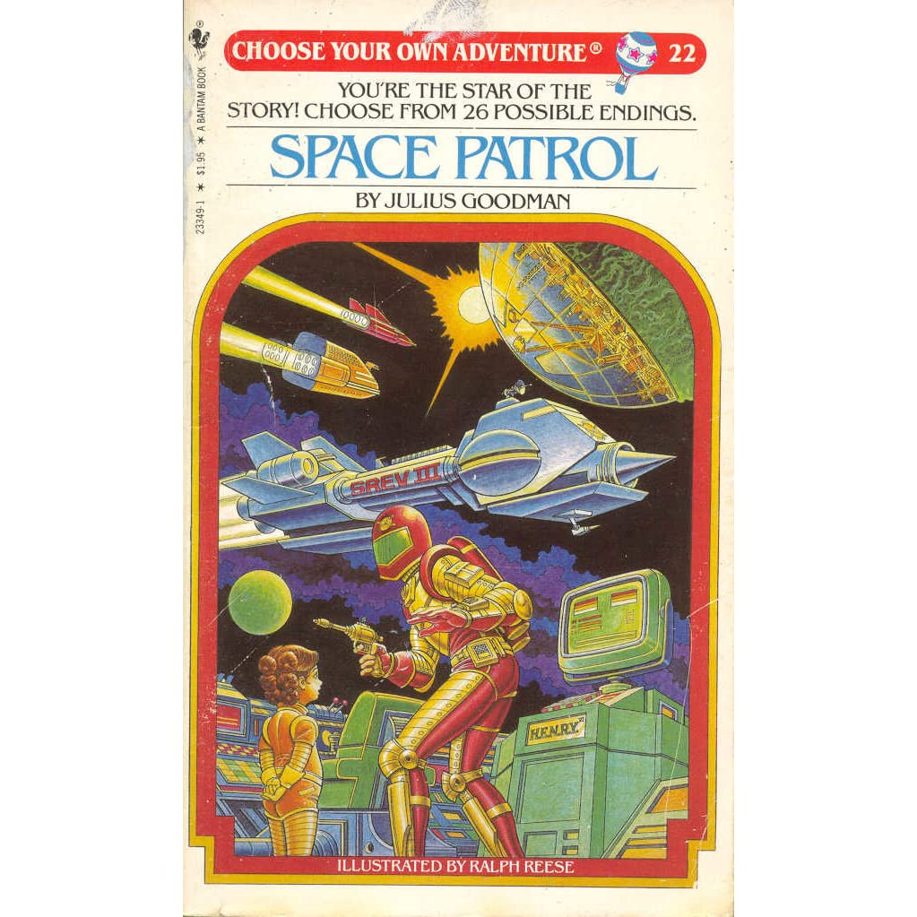
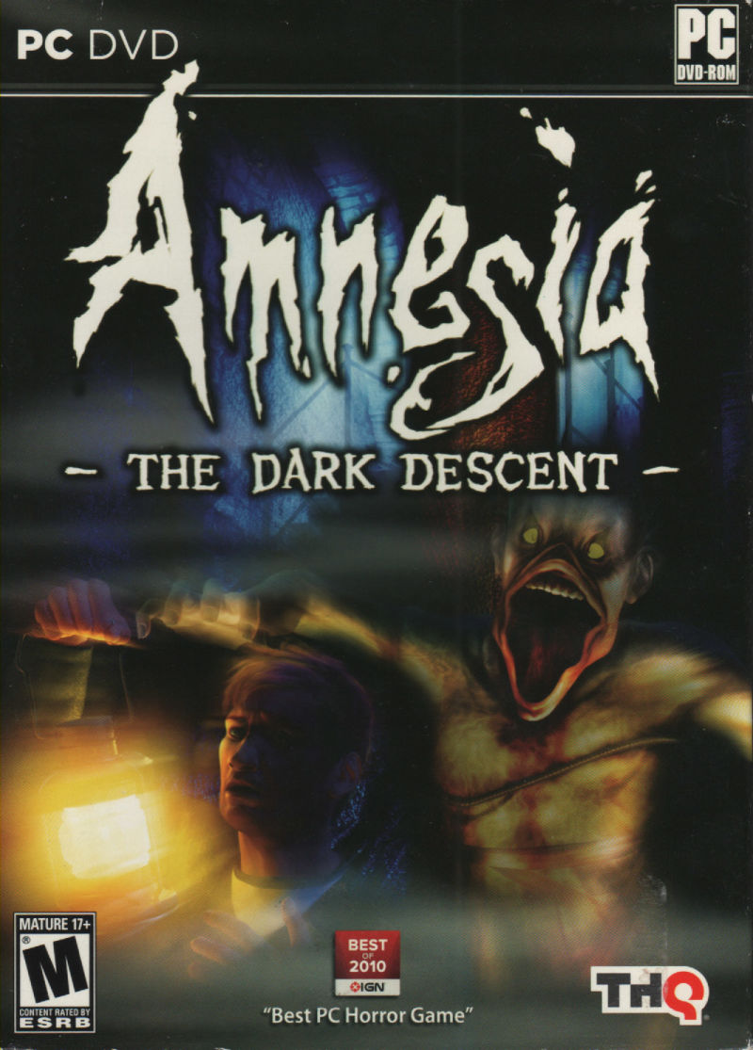
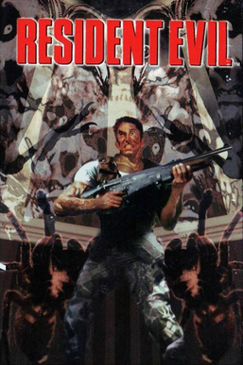
Application Overview
Choose your own adventure text game
Focus on horror/mystery genre
Multi-linear, however fixed input/output
Multiple endings to enhance replayability

Slide 3
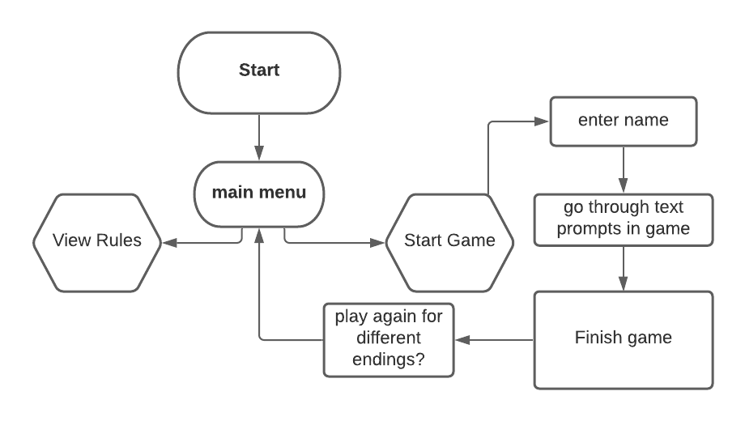
Flow Chart - Initial Design

Slide 4
Purpose
Sentimental nature of late 20th century video games
“Retro renaissance” - increasing popularity of old school videogames, board games and trends in fashion and popular culture as well - cultural revival.
An exploration of the most fundamental elements of RUBY and how even at its most basic the language can be used for storytelling and entertainment.
Target audience - gamers, 80’s-90’s tech enthusiasts, fans of horror. Age demographics 15 and above due to horror themes in game.

Slide 5
Features
Interactive main menu which allows the user to access Game Instructions, an about section, the ability to start the game or to quit the application. This feature was completed through the use of Ruby Gem TTY Multi-linear pathways through the game - I have limited the endings to three - a good, bad and neutral ending. Scripting has been written - still in development.
An Inventory system through classes to store and utilise special items found in the game - this feature is fairly rudimentary due to game length and still in stages of development.
Additional RUBY Gems such as colorize,

Slide 6
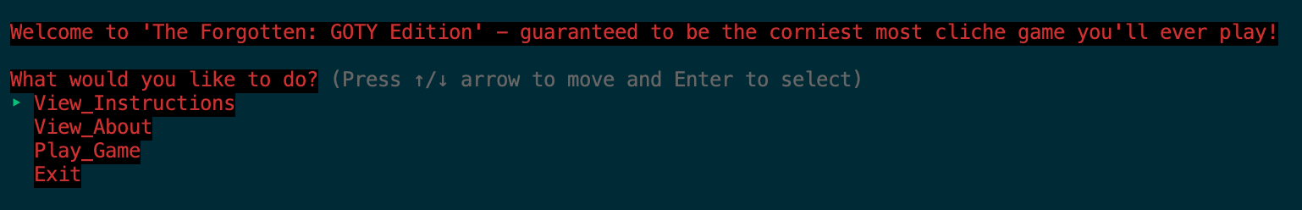
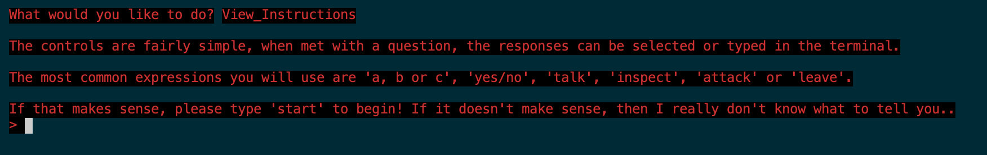
Code Overview - Main Menu

Slide 7
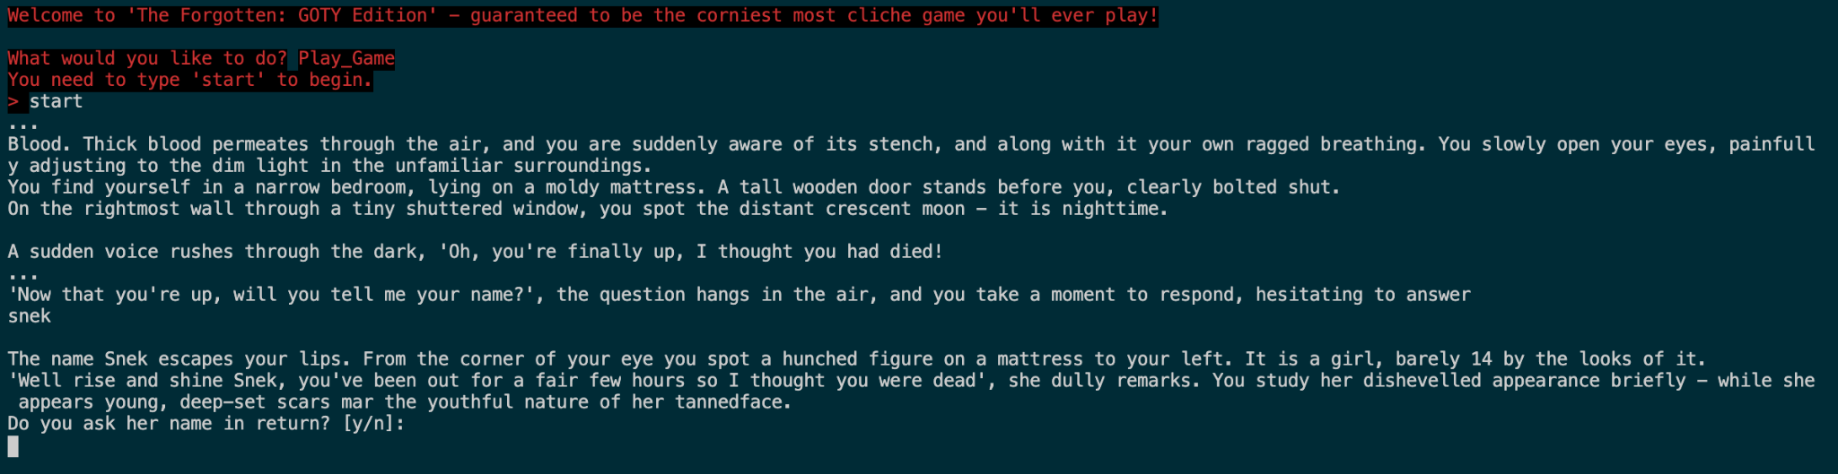
Code Overview

Slide 8
Challenges
TIME MANAGEMENT
Ensuring code is DRY
App is very wordy - desire was to make it like a book, but may be too much
Determining what kind of syntax/code to use
Writing pseudocode for everything
Recapping ruby to know exactly how to make the application I want
TDD

Slide 9
Ethical Issues
Originality, ensuring there is no plagiarism or story elements that are wholly derived from existing intellectual property.
Stigmatisation of videogames and their role in society - whether they lead to increased violence and theft, or behavioural disorders through addiction, this is not so much a personal ethical issue for the development of my app, but one that video game developers and many software developers need to ask to encourage productive discussions.

Slide 10
What I Really Enjoyed/Am Enjoying
Gratification of creating something from scratch
Creative process of app ideation and story design
Emerging ideas as I was working on the code
Positive conditioning with Git commits and pushes
Learning through practice

